Slide 1



Microsoft Azure & Linux Workshop - Welcome
#msdevuk #azure
vipazure@microsoft.com
Microsoft Linux
https://github.com/dxuk/
AzureWorkshops
David Gristwood
David.Gristwood@microsoft.com
@ScroffTheBad

Slide 2
 | Session Title | Who
10:00 | Intro to Azure & Linux on Azure | David/Marcus
 | Development Tools: Azure CLI, VS Code, Bash on Windows | Joni/Marcus
 | Intro to Azure IaaS | Will
11:30 | Break
 | Ubuntu and Azure | Canonical
 | Configuration Management, Security/Compliance | Chef
13:00 | Lunch
13:45 | Microservices on Azure & Service Fabric | Joni
 | Docker + Azure Container Service | Marcus
 | Juju | Canonical
 | Habitat | Chef
 | App Service on Linux | Marcus
16:00 | Networking etc.
Notes:
First run with content,

Slide 3

https://pollev.com/ukdx
Notes:
https://www.polleverywhere.com/multiple_choice_polls/tB2ywb8sXljcKpp

Slide 4
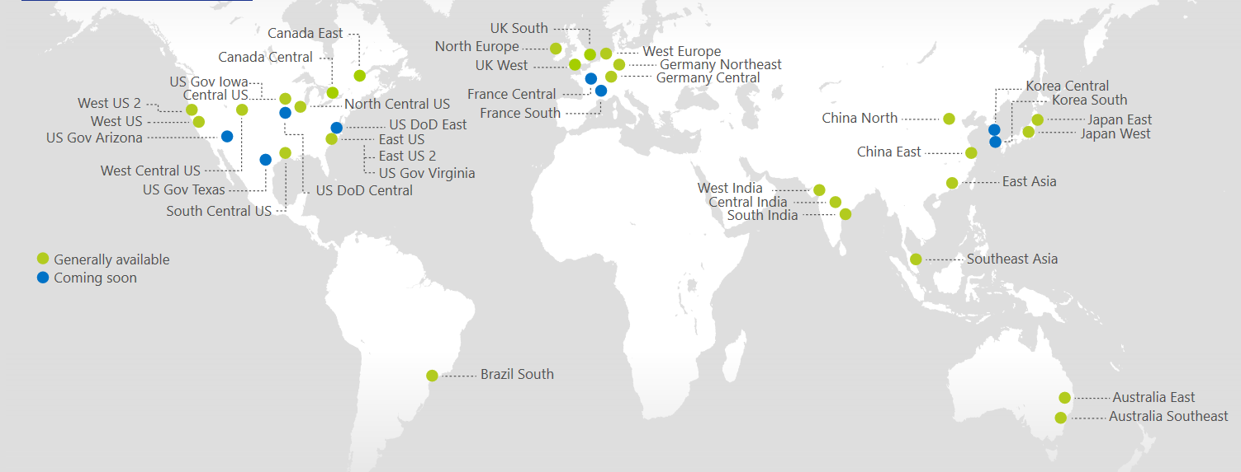
Azure Regions
https://azure.microsoft.com/regions/
Azure is generally available in 30 regions around the world, and has announced plans for 8 additional regions
Notes:
http://azuredatacentermap.azurewebsites.net/

Slide 5
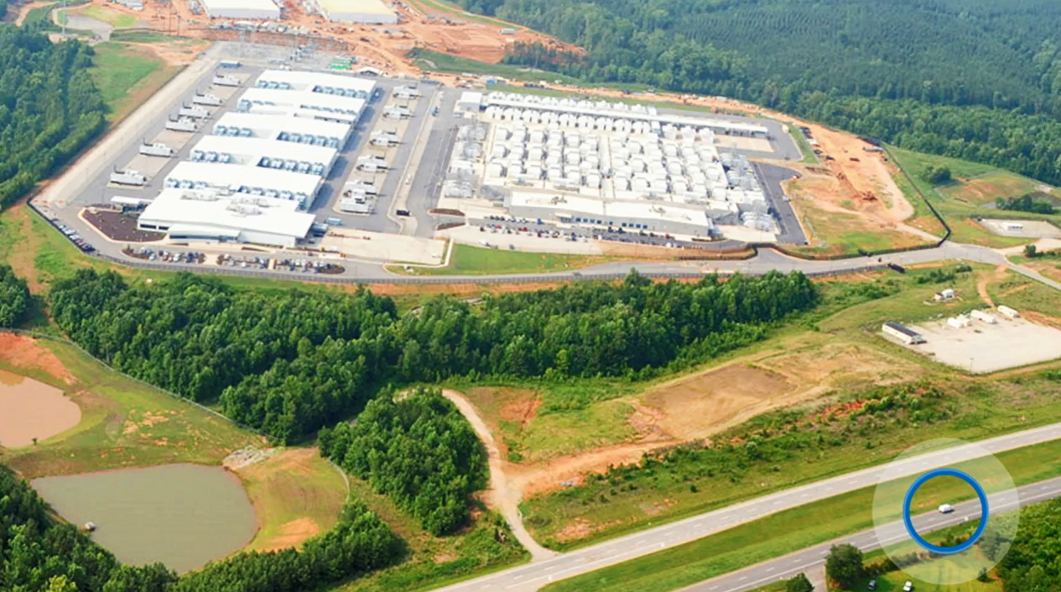

Slide 6

https://www.microsoft.com/en-gb/cloud-platform/global-datacenters
Notes:
https://www.microsoft.com/en-gb/cloud-platform/global-datacenters

Slide 7
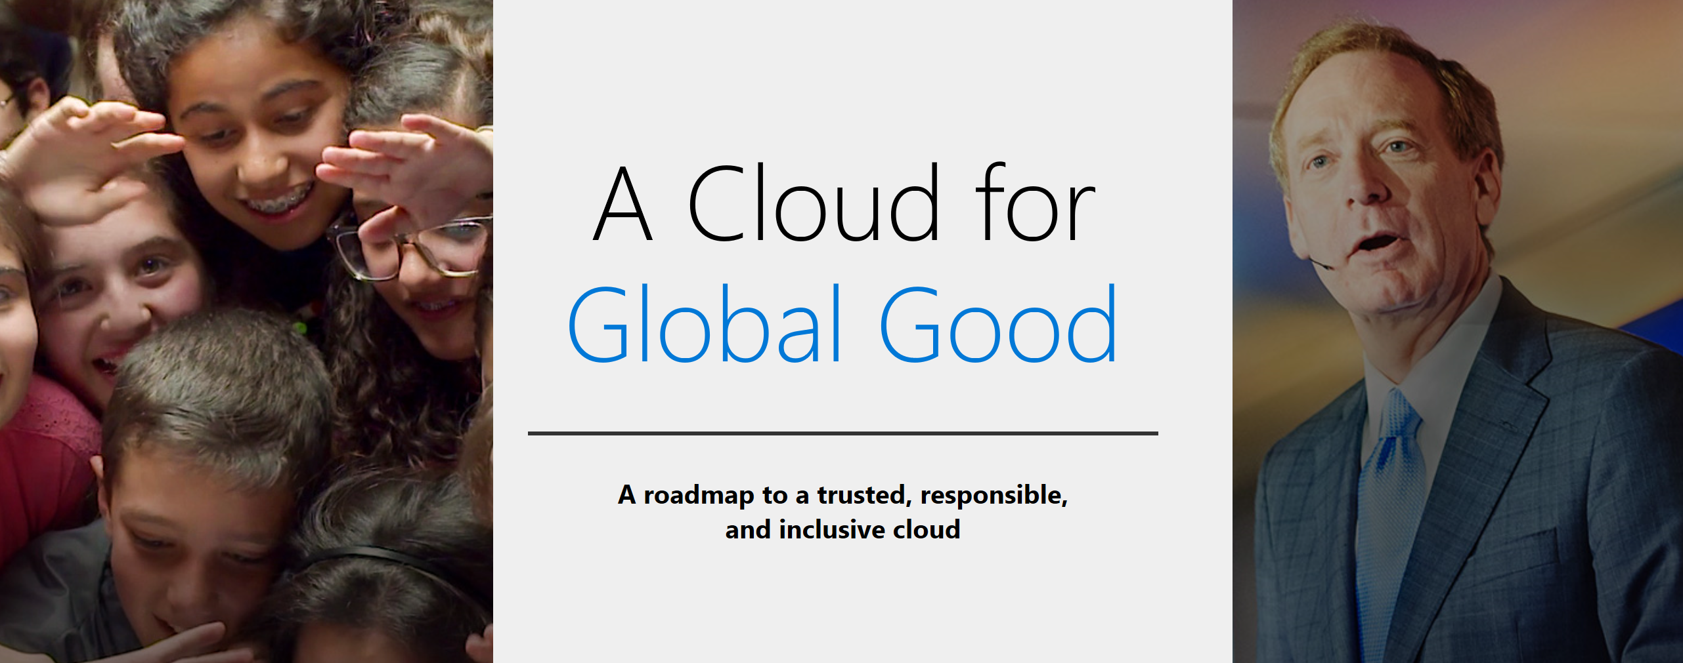
news.microsoft.com/cloudforgood

Slide 8
What’s next….
More strongly themed Azure workshops
Data on Azure – 15th Feb
The Intelligent Cloud featuring Bots masterclass – 14th March
Azure “best practices” workshops
Implementing Security and Identity in the Cloud – Feb 23rd
Designing Highly Scalable and Available Cloud Solutions - March 23rd
Webinar series
Getting Started on Azure - Feb 7th, March 7th
Machine Learning - Feb 21st
Azure Functions & Serverless Computing - March 16th
email vipazure@microsoft.com

